Slide 1
Is The New Testament A PATTERN?
What Is The Design Of The New Testament?
(part 1)

Slide 2
“Pattern”
Not speaking of:
  Patterns in nature (sand dunes, stripes on zebras, honeycomb, cracks in dry mud, etc.)
  Fibonacci patterns (1, 1, 2, 3, 5, 8, 13, 21, 34, etc.)
  A decorative design

Slide 3
“Pattern”
plan or model
a plan or model used as a guide for making something (Encarta, def. 3)
“Now King Ahaz went to Damascus to meet Tiglath-Pileser king of Assyria, and saw an altar that was at Damascus; and King Ahaz sent to Urijah the priest the design of the altar and its pattern, according to all its workmanship.”
2 Kings 16:10

Slide 4
When Men Do Not Recognize God’s Pattern
Judges 17:6; 21:25
“In those days there was no king in Israel; everyone did what was right in his own eyes.”
Deut. 12:8
“You shall not at all do as we are doing here today—every man doing whatever is right in his own eyes”
Proverbs 12:15
“The way of a fool is right in his own eyes, But he who heeds counsel is wise”

Slide 5
When Men Do Not Recognize God’s Pattern
Proverbs 14:12; 16:25
“There is a way that seems right to a man, But its end is the way of death.”
Jeremiah 10:23
“O LORD, I know the way of man is not in himself; It is not in man who walks to direct his own steps.”

Slide 6

THE PATRIARCHAL
A PATTERN

Slide 7
Law, Sin, Death
Death requires the presence of sin
Sin requires the presence of law
MOSES
Death Reigned (Rom. 5:12-14)
~2500 yrs.
PATRIARCHAL
Law & Sin
ADAM
“…for sin is the transgression of the law” (1 Jn. 3:4, KJV)
“Nevertheless death reigned from Adam to Moses…”
(Rom. 5:14)

Slide 8
Law, Sin, Death
Death requires the presence of sin
Sin requires the presence of law
MOSES
Death Reigned (Rom. 5:12-14)
~2500 yrs.
PATRIARCHAL
Noah (Gen. 6:8, 9, 22)
A Pattern Existed!
Law & Sin
ADAM
Cain & Abel
(Gen. 4:1-7)

Slide 9
THE MOSAICAL
A PATTERN

Slide 10
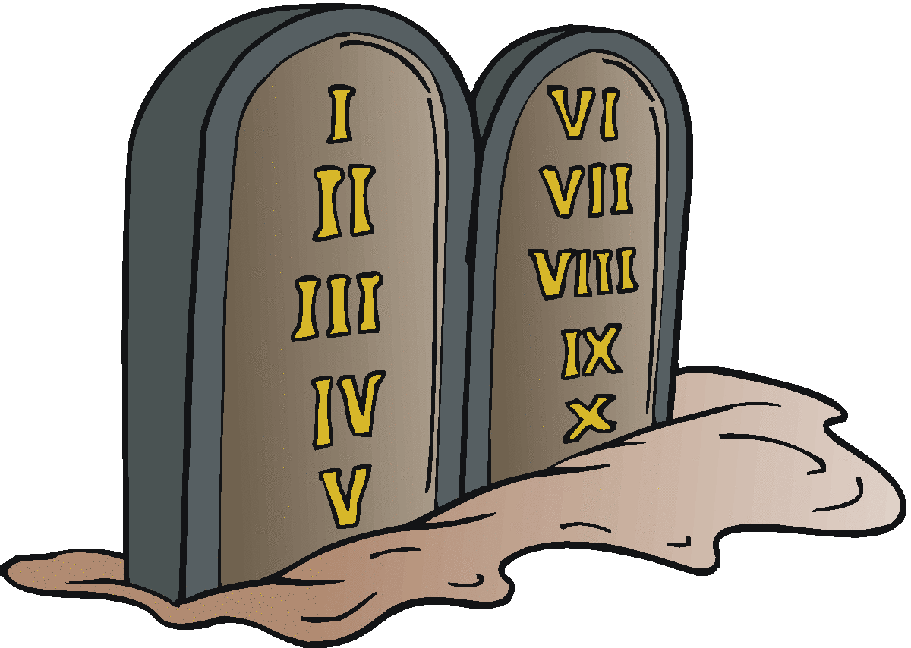
A PATTERN
JESUS
~1500 yrs.
MOSAICAL
MOSES
“as the LORD had commanded Moses”
“…see to it that you make them according to the pattern which was shown you on the mountain” (Ex. 25:40; cf. 25:9; 26:30; 27:8; Heb. 8:5)

Slide 11

1 Chronicles 13:1-11
JESUS
~1500 yrs.
MOSAICAL
MOSES
Failure with a “new cart” (13:1-11)
“How can I bring the ark of God to me?” (13:12)
ANSWER: By following the pattern (15:13)!

Slide 12

In The Next Lesson:
We Will List SIX Reasons Why The New Testament Is Our Pattern Today!

Slide 13
Have You Followed The Pattern?
TO BE SAVED
Believe
Repent
Confess
Baptized
Jn. 8:24
Lk. 15:10; 24:47
Lk. 12:8
Acts 8:12, 13, 15, 16, 36-38

